Slide 1
ESE516 CLOUD STARTER
Eduardo Garcia
Spring 2021

Slide 2
MQTT Tools

Slide 3
Setting up a mqtt broker
Go to http://www.mqtt-dashboard.com/index.html
This is a public MQTT broker. You can find the parameters to join on the right. You do not need to do any action at this point – it is just informative!
MQTT connection settings
Host: broker.hivemq.com TCP Port: 1883 Websocket Port: 8000

Slide 4
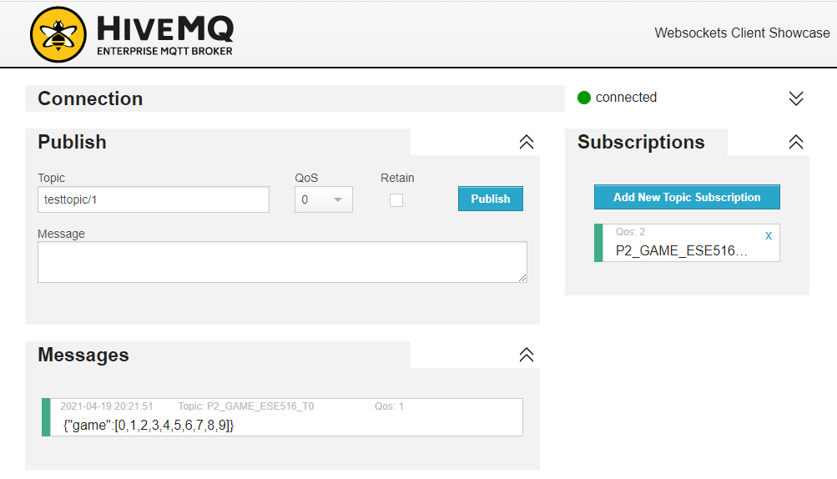
MQTT Client
http://www.hivemq.com/demos/websocket-client/
You can use this website client to connect to the MQTT server and publish/subscribe to topics. This can be really useful to determine that data is getting to the system.

Slide 5
SETUP – IBM NODE RED

Slide 6
IBM CLOUD ACCOUNT
Make an account at https://ibm.biz/BdZDGp

Slide 7
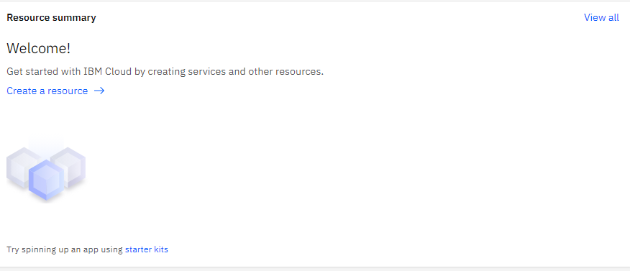
Add resource
Once you have your account ready, you will be greeted with the IBM Cloud Dashboard. Click on the “Create” under the “Resource Summary”

Slide 8
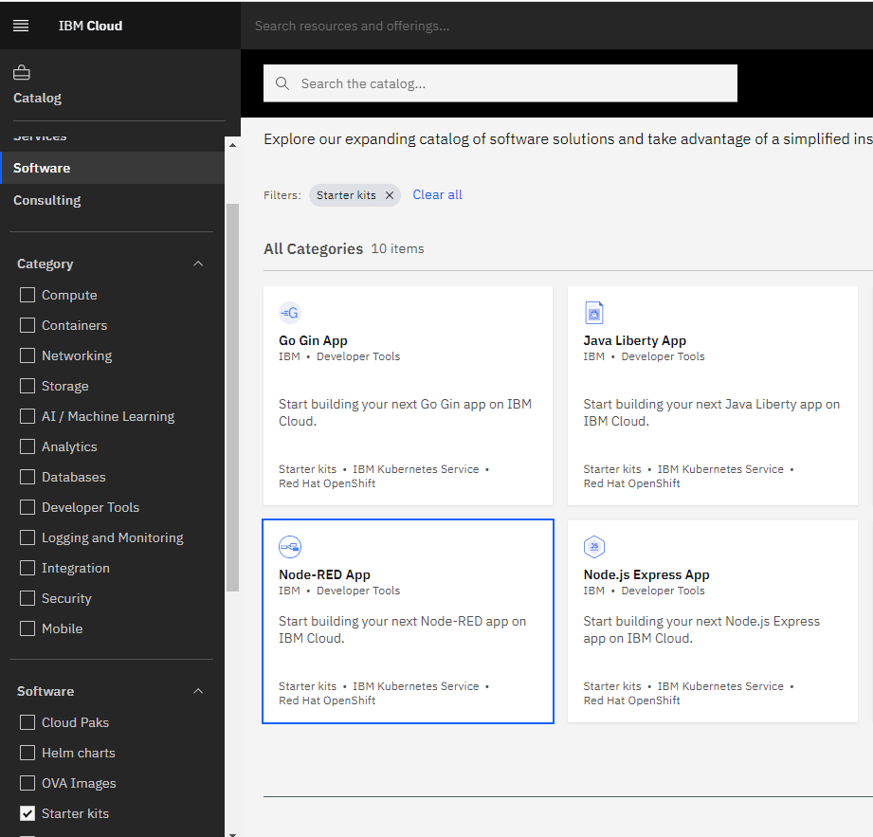
Add resource
Once you have your account ready, you will be greeted with the IBM Cloud Dashboard. Click on the “Create” under the “Resource Summary”

Slide 9
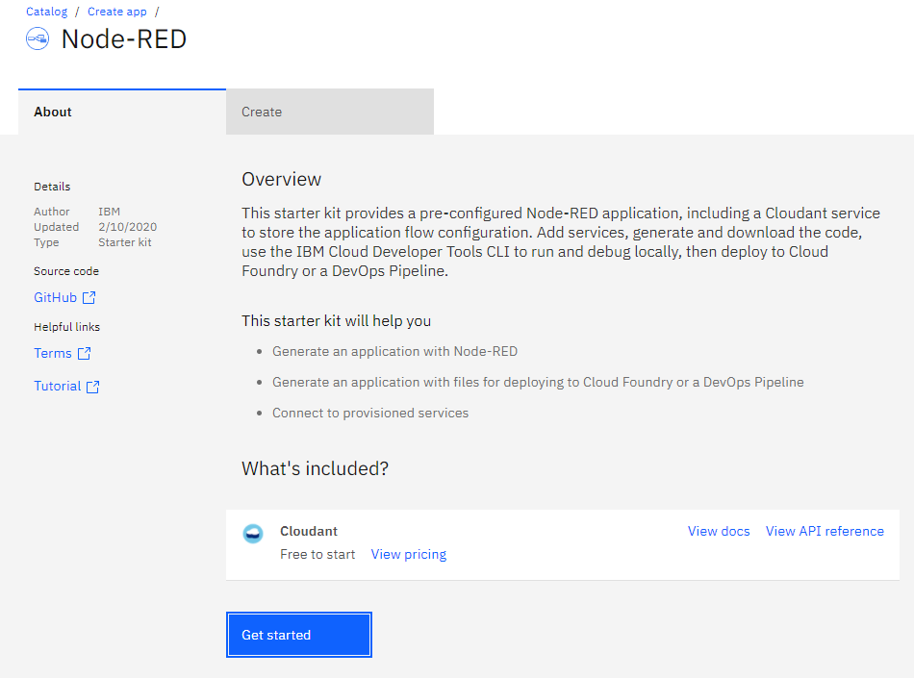
Get Started

Slide 10
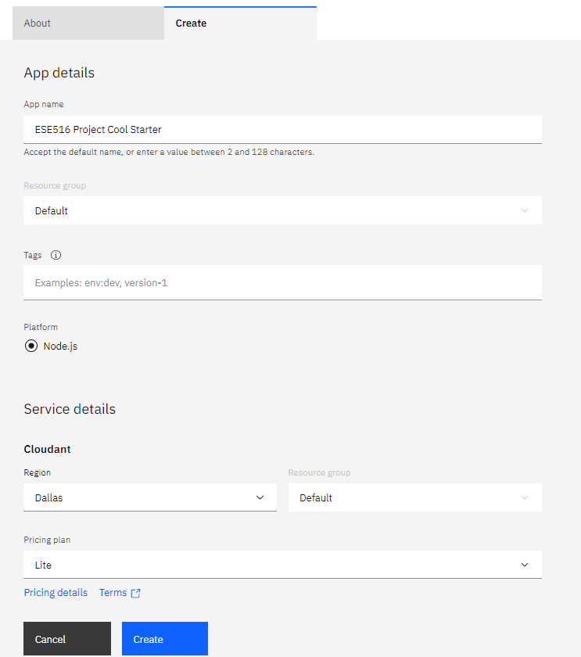
Set a name – any name!

Slide 11
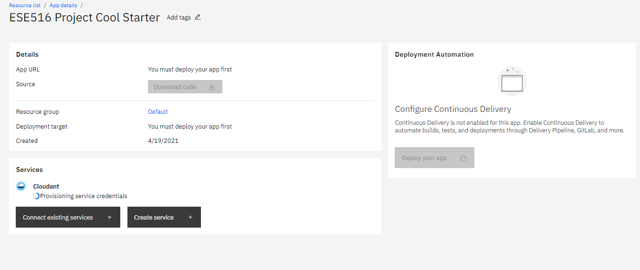
Wait a minute for system to load!

Slide 12
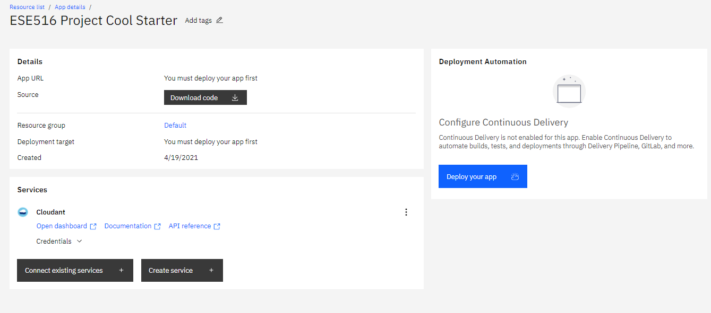

Slide 13
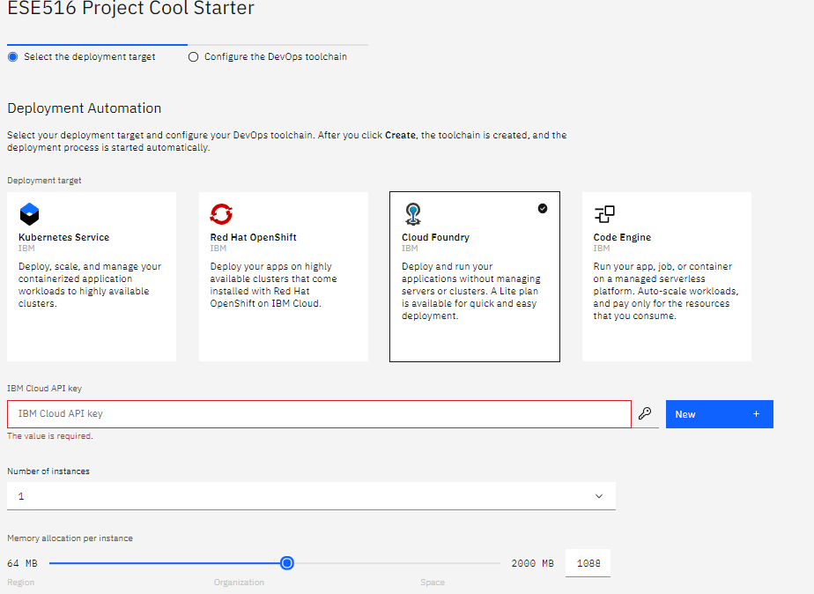
Select the following.
Press “New” to generate a key. You can copy it somewhere if you like.

Slide 14
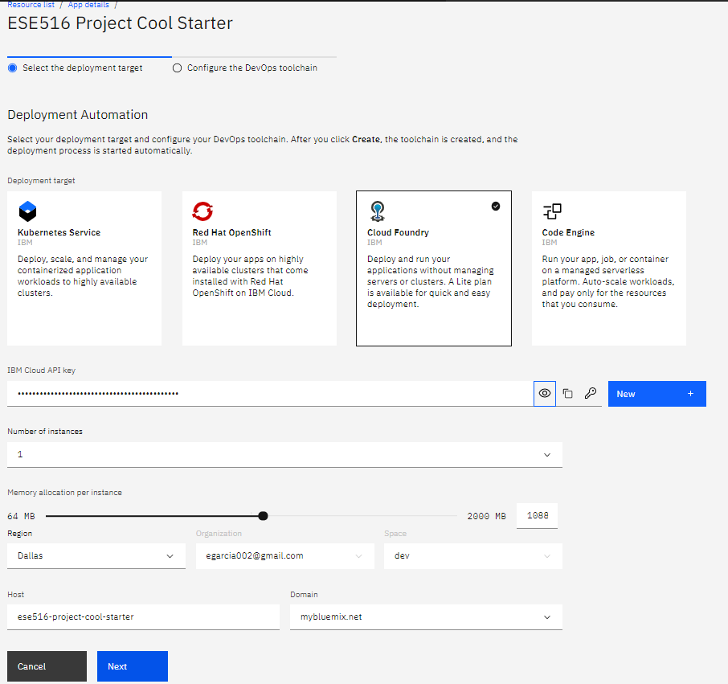
Give it 1000 MB of memory and hit next.
Do not provide more than 1 (one) GB of memory

Slide 15
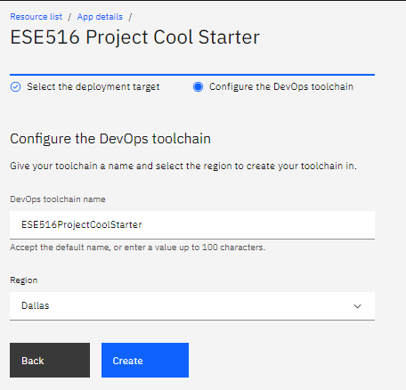

Slide 16
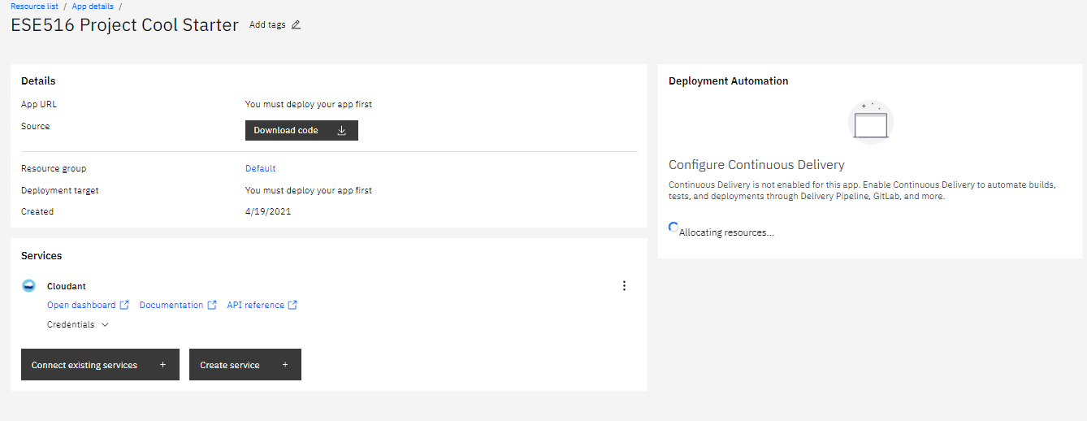
Wait a minute

Slide 17
Wait. Might need to refresh page if load icon disappears. Takes around 5 minutes.

Slide 18
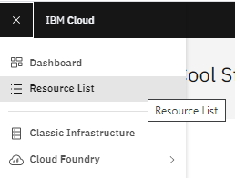
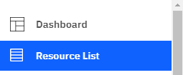
You can now access the resources made on the top left bar – under “Resource List”

Slide 19
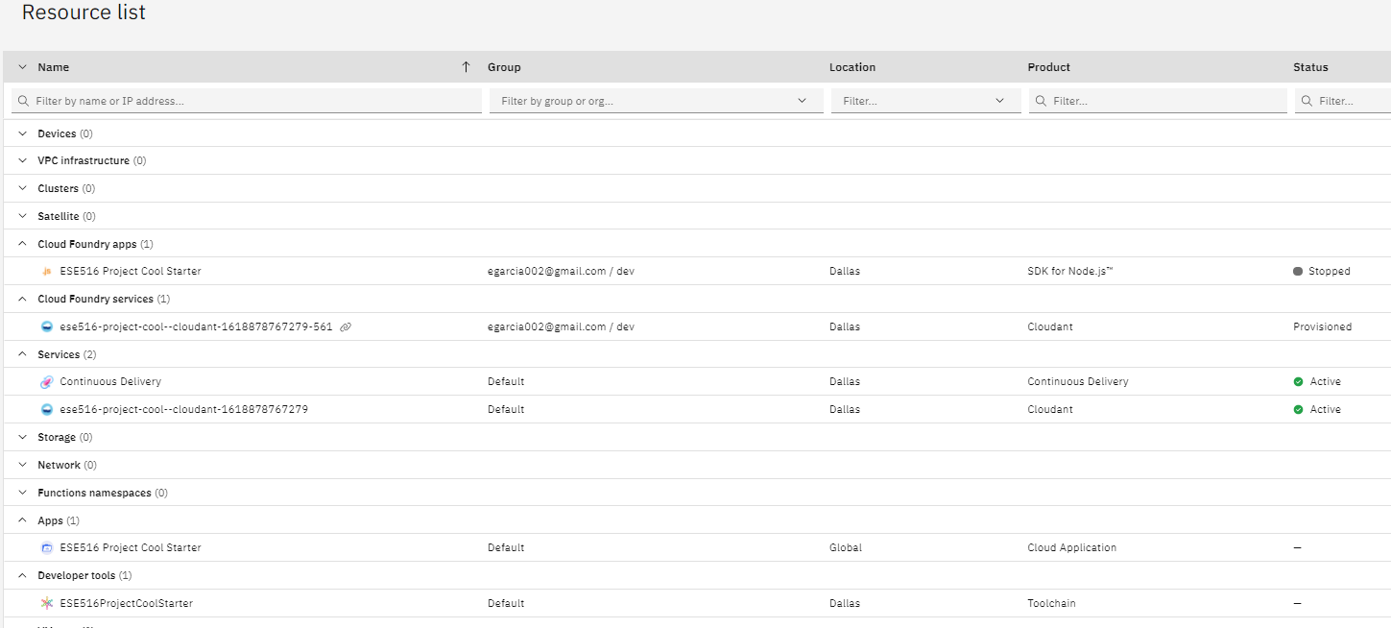
Node JS (For Node Red)
Here you can see the services started!
DB
Continuous Delivery
Node Red App

Slide 20
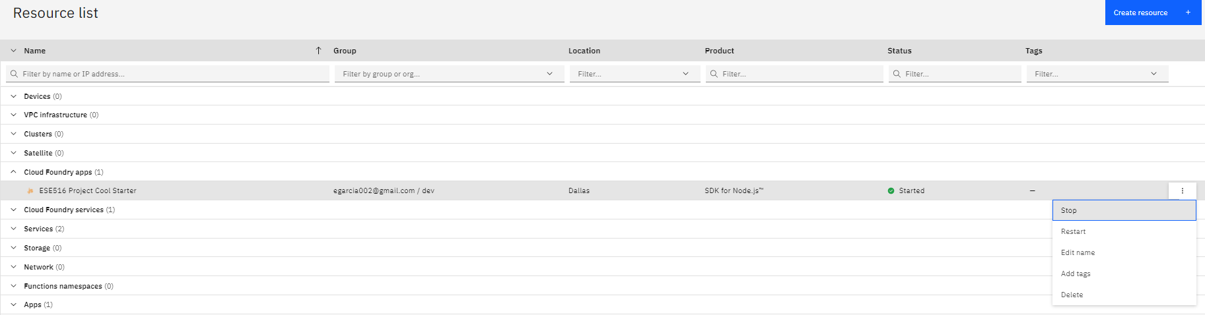
Before our next steps, we need to stop the current app. On the Could Foundry Apps, click on “Stop” to stop that process. You will encounter errors if you do not do this step.

Slide 21
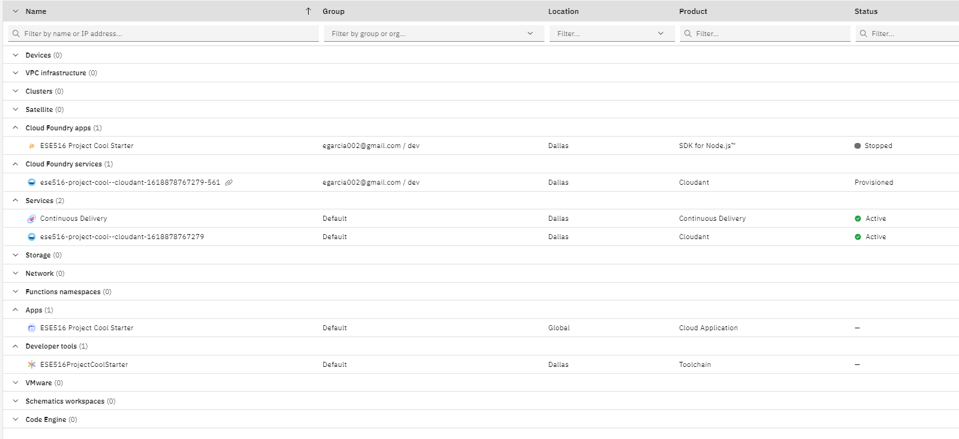
Before we begin, we have to install Node-Red modules for the system! Go to the Could Application under APPS

Slide 22
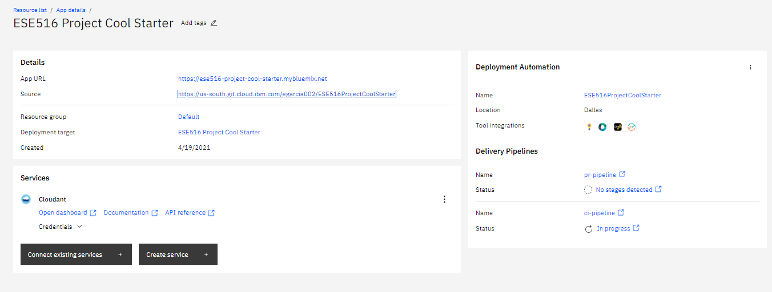
Here we will be able to access the Github project for our deployment. Click the link on the right as shown.

Slide 23
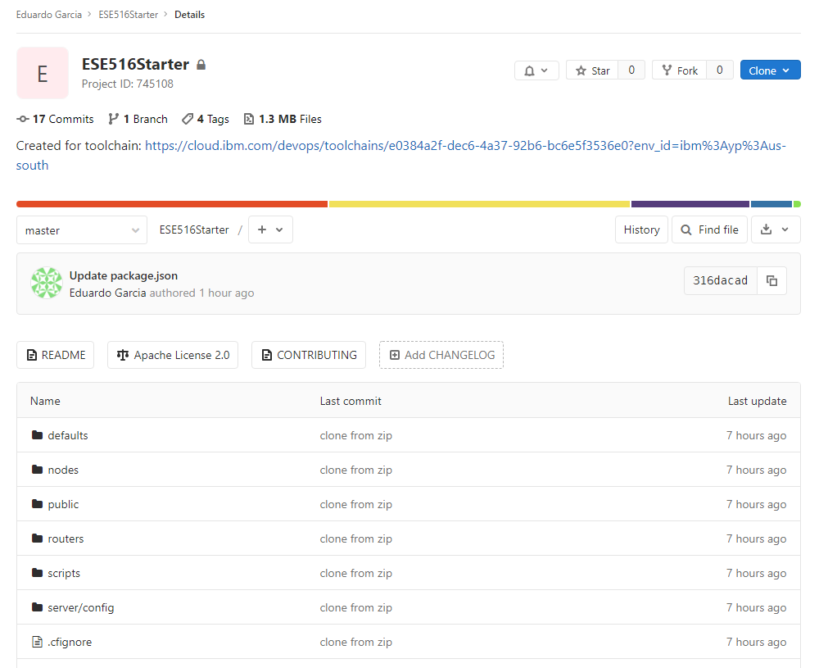
This will take you to a Github page with code for the Node-Red deployment.
We will modify two files for the following:
Manifest.yml: To tell the cloud we only need 256mB so they don’t charge us!
Package.json: To install some useful NODE-RED nodes!

Slide 24
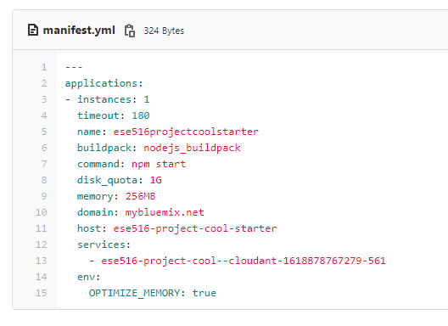
Open manifest.yml
Hit “Edit”
Change
Memory to 256 MB
(Before it was 1G)
Hit “Commit Changes”

Slide 25
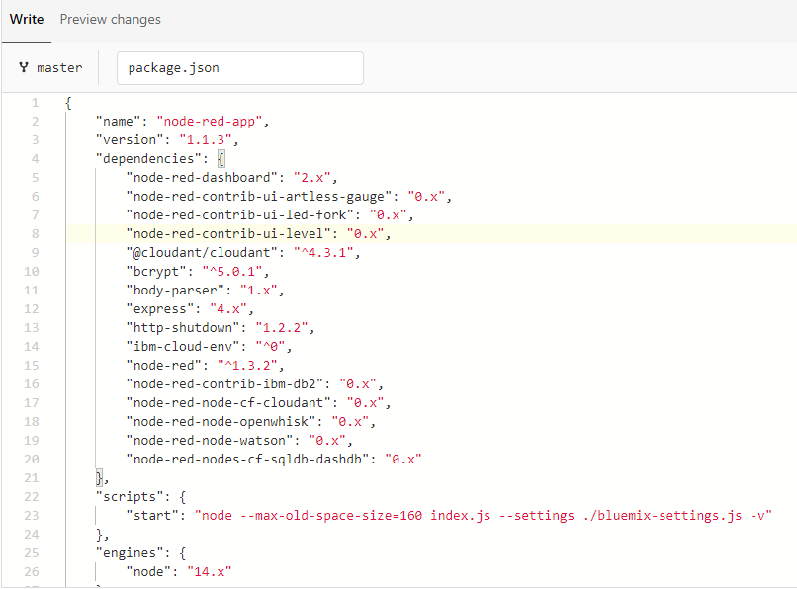
Open package.json
Hit “Edit”
Add the following at the very top of the dependencies:
"node-red-dashboard": "2.x", "node-red-contrib-ui-artless-gauge": "0.x", "node-red-contrib-ui-led-fork": "0.x", "node-red-contrib-ui-level": "0.x",
Hit “Commit Changes”

Slide 26
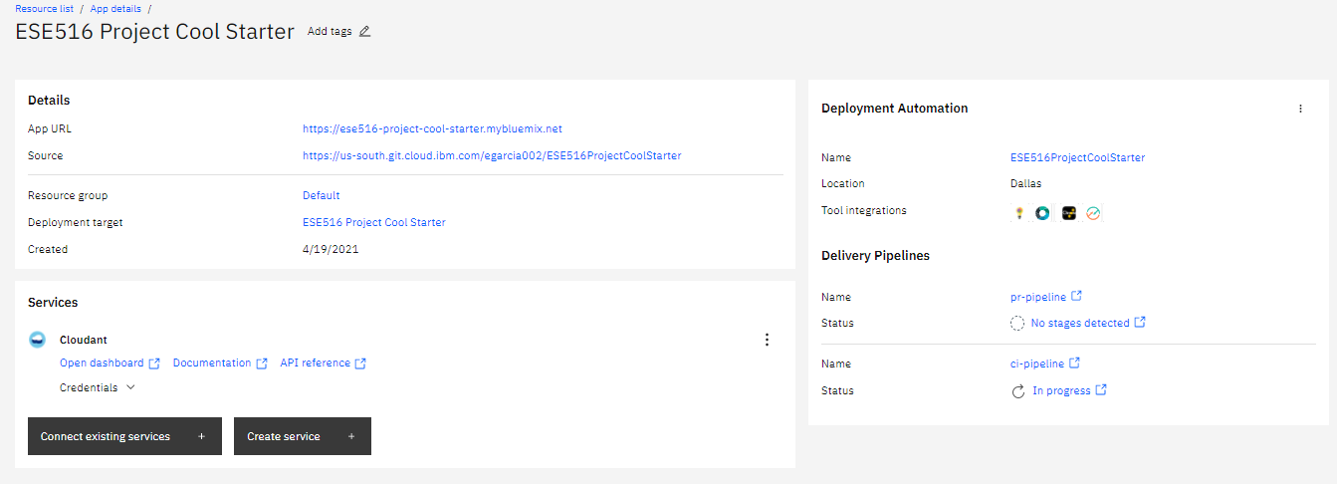
Click here to see progress of compilation

Slide 27
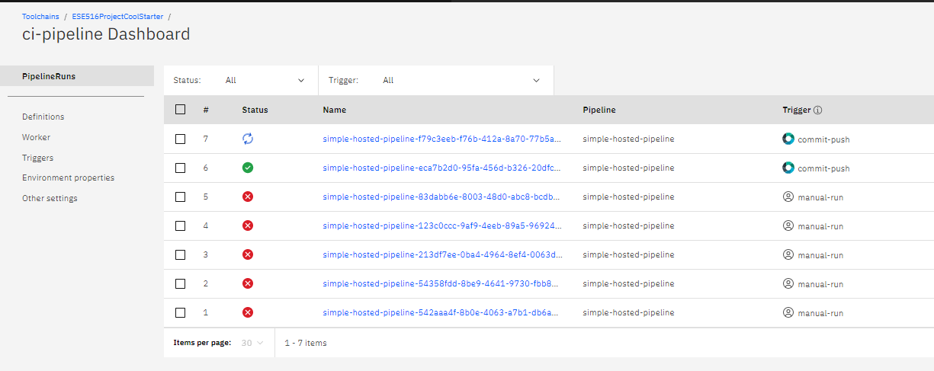
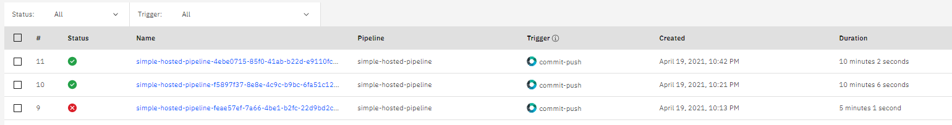
When you changed the code, it triggered an automatic rebuild. The system will tell you the state of the new build and deploy on the cloud. Wait until everything passed! If you had errors… Time for Piazza! It will take a while! ~ 5-10 min.
Yay! It passed!

Slide 28
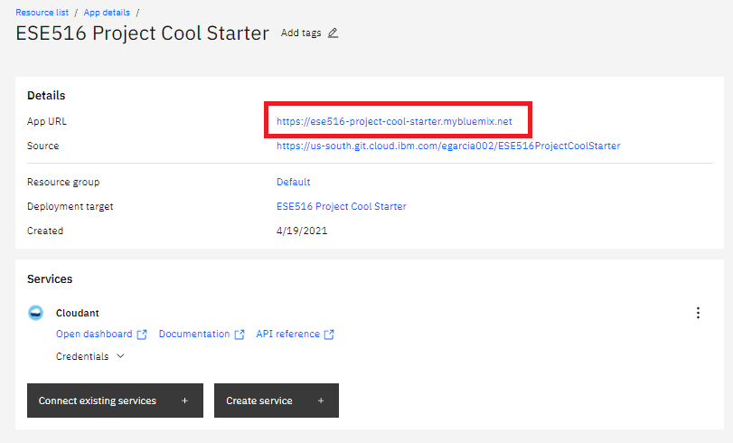
Go back and click this link. It will take you to the Node Red instance

Slide 29
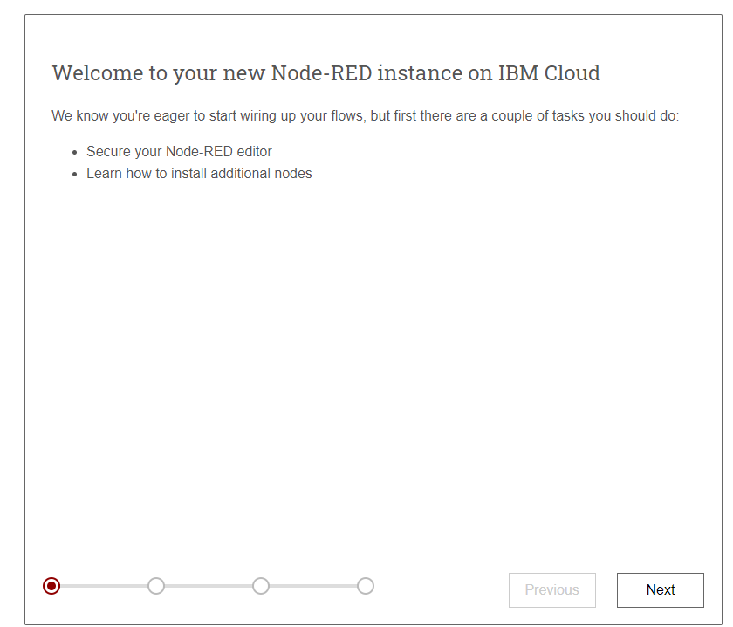
Go thru the next steps
Choose a password you can share with your class partner, and is easy to remember!

Slide 30
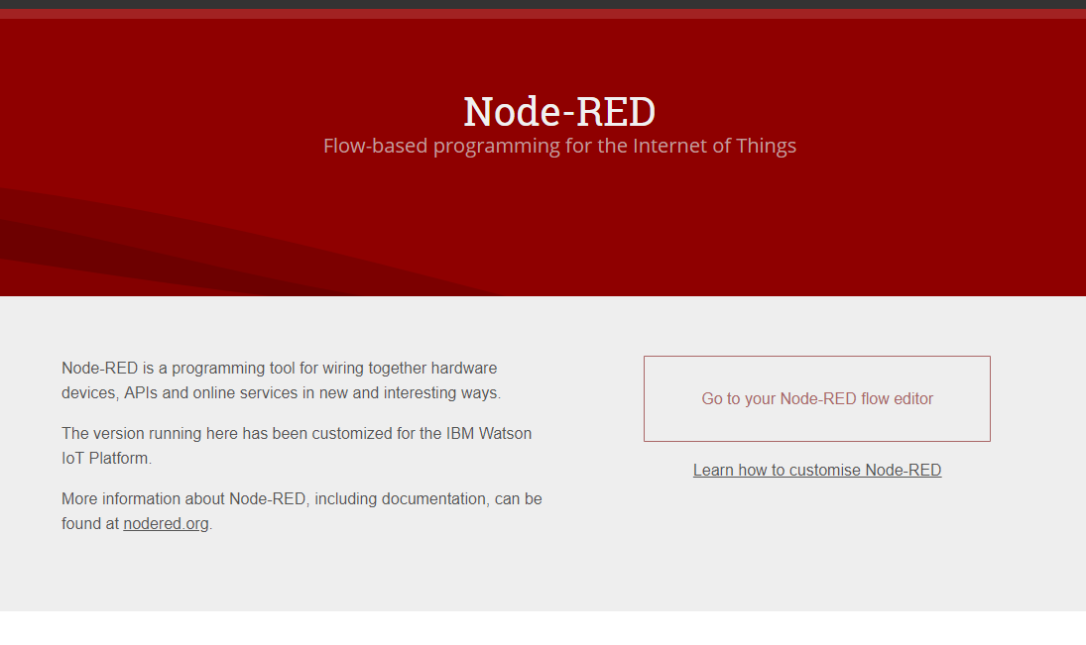
Node-Red
Your Node-Red is now ready! Click on the “Go To your Node-RED flow editor” to open the editor. Otherwise, click on “Learn how to customize Node RED” for a quick tutorial to start up.

Slide 31
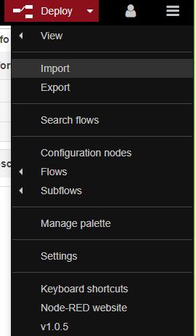
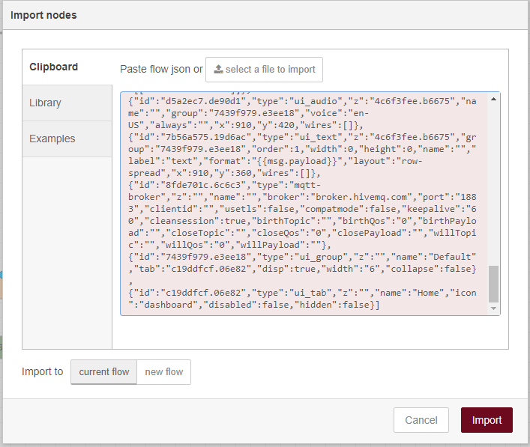
[{"id":"4c6f3fee.b6675","type":"tab","label":"Flow 1","disabled":false,"info":""},{"id":"5ac91ff3.86fef","type":"tab","label":"2 player game simulation","disabled":false,"info":""},{"id":"116f1ff.480b0e","type":"tab","label":"Simulation Game Board","disabled":false,"info":""},{"id":"8fde701c.6c6c3","type":"mqtt-broker","z":"","name":"","broker":"broker.hivemq.com","port":"1883","clientid":"","usetls":false,"compatmode":false,"keepalive":"60","cleansession":true,"birthTopic":"","birthQos":"0","birthPayload":"","closeTopic":"","closeQos":"0","closePayload":"","willTopic":"","willQos":"0","willPayload":""},{"id":"c19ddfcf.06e82","type":"ui_tab","z":"","name":"Home","icon":"dashboard","disabled":false,"hidden":false},{"id":"7439f979.e3ee18","type":"ui_group","z":"","name":"Default","tab":"c19ddfcf.06e82","disp":true,"width":"6","collapse":false},{"id":"3dd7f020.68187","type":"ui_base","theme":{"name":"theme-dark","lightTheme":{"default":"#0094CE","baseColor":"#0094CE","baseFont":"-apple-system,BlinkMacSystemFont,Segoe UI,Roboto,Oxygen-Sans,Ubuntu,Cantarell,Helvetica Neue,sans-serif","edited":true,"reset":false},"darkTheme":{"default":"#097479","baseColor":"#097479","baseFont":"-apple-system,BlinkMacSystemFont,Segoe UI,Roboto,Oxygen-Sans,Ubuntu,Cantarell,Helvetica Neue,sans-serif","edited":true,"reset":false},"customTheme":{"name":"Untitled Theme 1","default":"#4B7930","baseColor":"#4B7930","baseFont":"-apple-system,BlinkMacSystemFont,Segoe UI,Roboto,Oxygen-Sans,Ubuntu,Cantarell,Helvetica Neue,sans-serif"},"themeState":{"base-color":{"default":"#097479","value":"#097479","edited":false},"page-titlebar-backgroundColor":{"value":"#097479","edited":false},"page-backgroundColor":{"value":"#111111","edited":false},"page-sidebar-backgroundColor":{"value":"#000000","edited":false},"group-textColor":{"value":"#0eb8c0","edited":false},"group-borderColor":{"value":"#555555","edited":false},"group-backgroundColor":{"value":"#333333","edited":false},"widget-textColor":{"value":"#eeeeee","edited":false},"widget-backgroundColor":{"value":"#097479","edited":false},"widget-borderColor":{"value":"#333333","edited":false},"base-font":{"value":"-apple-system,BlinkMacSystemFont,Segoe UI,Roboto,Oxygen-Sans,Ubuntu,Cantarell,Helvetica Neue,sans-serif"}},"angularTheme":{"primary":"indigo","accents":"blue","warn":"red","background":"grey"}},"site":{"name":"Node-RED Dashboard","hideToolbar":"false","allowSwipe":"false","lockMenu":"false","allowTempTheme":"true","dateFormat":"DD/MM/YYYY","sizes":{"sx":48,"sy":48,"gx":4,"gy":4,"cx":6,"cy":6,"px":0,"py":0}}},{"id":"622b3681.b637e8","type":"ui_group","z":"","name":"2 Player Game Simulation","tab":"3c01459a.82910a","order":1,"disp":true,"width":"6","collapse":false},{"id":"3c01459a.82910a","type":"ui_tab","z":"","name":"2 Player Simulation","icon":"dashboard","order":2,"disabled":false,"hidden":false},{"id":"43e5bb99.cfe0e4","type":"ui_tab","z":"","name":"One Player Game","icon":"dashboard","order":3,"disabled":false,"hidden":false},{"id":"eff19175.c358e","type":"ui_group","z":"","name":"Color","tab":"43e5bb99.cfe0e4","order":1,"disp":true,"width":"6","collapse":false},{"id":"d7d463f4.cae2c","type":"ui_group","z":"","name":"P1 LED Board","tab":"3c01459a.82910a","order":2,"disp":true,"width":"4","collapse":false},{"id":"4c314b97.169624","type":"ui_spacer","name":"spacer","group":"d7d463f4.cae2c","order":2,"width":1,"height":1},{"id":"1980e43f.b4d11c","type":"function","z":"4c6f3fee.b6675","name":"temp","func":"return {payload:msg.payload.d.temp};","outputs":1,"noerr":0,"x":390,"y":480,"wires":[["48c3b8d0.9c3558"]]},{"id":"48c3b8d0.9c3558","type":"switch","z":"4c6f3fee.b6675","name":"temp thresh","property":"payload","propertyType":"msg","rules":[{"t":"lte","v":"40","vt":"str"},{"t":"gt","v":"40","vt":"str"}],"checkall":"true","repair":false,"outputs":2,"x":550,"y":480,"wires":[["5af543bd.70630c"],["c3eb20e6.6fb63"]]},{"id":"6e974680.39cd28","type":"debug","z":"4c6f3fee.b6675","name":"cpu status","active":false,"complete":"false","x":890,"y":480,"wires":[]},{"id":"ea07eb98.bc0448","type":"debug","z":"4c6f3fee.b6675","name":"device data","active":false,"console":"false","complete":"true","x":410,"y":560,"wires":[]},{"id":"5af543bd.70630c","type":"template","z":"4c6f3fee.b6675","name":"safe","field":"payload","fieldType":"msg","syntax":"mustache","template":"Temperature ({{payload}}) within safe limits","x":710,"y":460,"wires":[["6e974680.39cd28","7b56a575.19d6ac"]]},{"id":"c3eb20e6.6fb63","type":"template","z":"4c6f3fee.b6675","name":"danger","template":"Temperature ({{payload}}) critical","x":720,"y":500,"wires":[["6e974680.39cd28"]]},{"id":"3db4e4f7.4a9dfc","type":"inject","z":"4c6f3fee.b6675","name":"Send Data","topic":"","payload":"true","payloadType":"bool","repeat":"","crontab":"","once":false,"x":120,"y":140,"wires":[["20164732.524cf8"]]},{"id":"20164732.524cf8","type":"function","z":"4c6f3fee.b6675","name":"Device payload","func":"// Thermostat's location:\nvar longitude1 = -98.49;\nvar latitude1 = 29.42;\n\n// Array of pseudo random temperatures\nvar temp1 = [15,17,18.5,20,21.5,23,24,22.2,19,18];\n\n// Array of pseudo random relative humidities\nvar humidity1 = [50,55,61,68,65,60,53,49,45,47];\n\n// Counter to select from array.\nvar counter1 = context.get('counter1')||0;\ncounter1 = counter1+1;\nif(counter1 > 9) counter1 = 0;\ncontext.set('counter1',counter1);\n\n// Create MQTT message in JSON\nmsg = {\n payload: JSON.stringify(\n {\n d:{\n \"temp\" : temp1[counter1],\n \"humidity\" : humidity1[counter1],\n \"location\" :\n {\n \"longitude\" : longitude1,\n \"latitude\" : latitude1\n },\n }\n }\n )\n};\nreturn msg;\n","outputs":1,"noerr":0,"x":340,"y":140,"wires":[["5f9f3a85.1b8ff4","d632271c.8819e8"]]},{"id":"5f9f3a85.1b8ff4","type":"debug","z":"4c6f3fee.b6675","name":"Debug output payload","active":false,"console":"false","complete":"payload","x":580,"y":200,"wires":[]},{"id":"33e5da99.a54c16","type":"comment","z":"4c6f3fee.b6675","name":"Device Simulator","info":"Sends simulated device sensor data to IBM Watson IoT Plaform.\n\nCan be configured to send on click or on an automatic interval.\n\n\n#Prerequisite\nOutput node device type and device ID need to match a device that it registered in a running IBM Watson IoT Platform service.\n\n# Watson IoT Platform docs\n[Connecting devices](https://www.bluemix.net/docs/services/IoT/iotplatform_task.html)","x":120,"y":60,"wires":[]},{"id":"c742e956.a93c08","type":"comment","z":"4c6f3fee.b6675","name":"1. Configure target","info":"","x":570,"y":100,"wires":[]},{"id":"eee1d834.9e4158","type":"comment","z":"4c6f3fee.b6675","name":"2. Click to send data","info":"To automatically send data:\n1. Change *Repeat* to interval.\n2. Click Deploy button.\n","x":130,"y":180,"wires":[]},{"id":"5f5d259.a7f9cdc","type":"comment","z":"4c6f3fee.b6675","name":"Temperature Monitor","info":"","x":210,"y":380,"wires":[]},{"id":"f573da3c.d9d7d8","type":"comment","z":"4c6f3fee.b6675","name":"Configure source","info":"","x":200,"y":440,"wires":[]},{"id":"cea7b111.fe71b","type":"json","z":"4c6f3fee.b6675","name":"","property":"payload","action":"","pretty":false,"x":230,"y":480,"wires":[["1980e43f.b4d11c","ea07eb98.bc0448"]]},{"id":"d632271c.8819e8","type":"mqtt out","z":"4c6f3fee.b6675","name":"","topic":"TempData","qos":"1","retain":"","broker":"8fde701c.6c6c3","x":790,"y":140,"wires":[]},{"id":"7b56a575.19d6ac","type":"ui_text","z":"4c6f3fee.b6675","group":"7439f979.e3ee18","order":1,"width":0,"height":0,"name":"","label":"text","format":"{{msg.payload}}","layout":"row-spread","x":910,"y":360,"wires":[]},{"id":"c0b9a71b.9ea2b8","type":"function","z":"5ac91ff3.86fef","name":"Add Play","func":"\nif(msg.payload.game.length <= 20){\n \n //Concatenate a play\n msg.payload.game.push(Math.round(Math.random()*15))\n \n}\nelse{\n //Pop out first game in list and add a new one at the end\n msg.payload.game.shift(); // Remove an item from the beginning of an array.\n msg.payload.game.push(Math.round(Math.random()*15))\n}\n\n\nreturn msg","outputs":1,"noerr":0,"x":560,"y":320,"wires":[["4004f32f.841acc","6a2ba603.56a918","285e1be5.e64a54"]]},{"id":"4004f32f.841acc","type":"debug","z":"5ac91ff3.86fef","name":"Debug output payload","active":false,"tosidebar":true,"console":false,"tostatus":false,"complete":"payload","targetType":"msg","x":840,"y":360,"wires":[]},{"id":"512750c.59b06b","type":"comment","z":"5ac91ff3.86fef","name":"Device Simulator - Press to Start a New Game","info":"Sends simulated device sensor data to IBM Watson IoT Plaform.\n\nCan be configured to send on click or on an automatic interval.\n\n\n#Prerequisite\nOutput node device type and device ID need to match a device that it registered in a running IBM Watson IoT Platform service.\n\n# Watson IoT Platform docs\n[Connecting devices](https://www.bluemix.net/docs/services/IoT/iotplatform_task.html)","x":270,"y":40,"wires":[]},{"id":"f996af79.0680f","type":"comment","z":"5ac91ff3.86fef","name":"Add move to P1 and send to P2","info":"","x":190,"y":240,"wires":[]},{"id":"df42a169.95838","type":"mqtt out","z":"5ac91ff3.86fef","name":"","topic":"P1_GAME_ESE516_T0","qos":"1","retain":"","broker":"8fde701c.6c6c3","x":750,"y":40,"wires":[]},{"id":"ca8ced29.a967c","type":"inject","z":"5ac91ff3.86fef","name":"","topic":"","payload":"{\"game\":[0]}","payloadType":"json","repeat":"","crontab":"","once":false,"onceDelay":0.1,"x":190,"y":80,"wires":[["bf064806.f9d048"]]},{"id":"a499c6df.4fc628","type":"debug","z":"5ac91ff3.86fef","name":"Debug output payload","active":false,"console":"false","complete":"payload","x":740,"y":100,"wires":[]},{"id":"aa913e41.84da","type":"mqtt in","z":"5ac91ff3.86fef","name":"","topic":"P1_GAME_ESE516_T0","qos":"1","datatype":"auto","broker":"8fde701c.6c6c3","x":200,"y":340,"wires":[["3f1df67f.27042a","cdc8ef25.6f588"]]},{"id":"3f1df67f.27042a","type":"debug","z":"5ac91ff3.86fef","name":"Debug output payload","active":false,"console":"false","complete":"payload","x":460,"y":460,"wires":[]},{"id":"cb535277.c48ac","type":"debug","z":"5ac91ff3.86fef","name":"Debug output payload","active":false,"tosidebar":true,"console":false,"tostatus":false,"complete":"payload","targetType":"msg","x":600,"y":400,"wires":[]},{"id":"cdc8ef25.6f588","type":"json","z":"5ac91ff3.86fef","name":"","property":"payload","action":"","pretty":false,"x":410,"y":320,"wires":[["c0b9a71b.9ea2b8","cb535277.c48ac"]]},{"id":"6a2ba603.56a918","type":"mqtt out","z":"5ac91ff3.86fef","name":"","topic":"P2_GAME_ESE516_T0","qos":"1","retain":"","broker":"8fde701c.6c6c3","x":870,"y":280,"wires":[]},{"id":"f924ab3.23dd358","type":"mqtt in","z":"5ac91ff3.86fef","name":"","topic":"P2_GAME_ESE516_T0","qos":"1","datatype":"auto","broker":"8fde701c.6c6c3","x":200,"y":600,"wires":[["a676c449.c87e88","a9b58c3.b276f7"]]},{"id":"5bcf18fa.29cbd8","type":"function","z":"5ac91ff3.86fef","name":"Add Play","func":"\nif(msg.payload.game.length <= 20){\n \n //Concatenate a play\n msg.payload.game.push(Math.round(Math.random()*15))\n \n}\nelse{\n //Pop out first game in list and add a new one at the end\n msg.payload.game.shift(); // Remove an item from the beginning of an array.\n msg.payload.game.push(Math.round(Math.random()*15))\n}\n\n\nreturn msg","outputs":1,"noerr":0,"x":580,"y":600,"wires":[["300afcfa.6035e4","e4c6da55.0408d8","229d5f64.5c929"]]},{"id":"300afcfa.6035e4","type":"debug","z":"5ac91ff3.86fef","name":"Debug output payload","active":false,"tosidebar":true,"console":false,"tostatus":false,"complete":"payload","targetType":"msg","x":820,"y":700,"wires":[]},{"id":"a9b58c3.b276f7","type":"debug","z":"5ac91ff3.86fef","name":"Debug output payload","active":false,"console":"false","complete":"payload","x":380,"y":740,"wires":[]},{"id":"885aa766.0de178","type":"debug","z":"5ac91ff3.86fef","name":"Debug output payload","active":false,"tosidebar":true,"console":false,"tostatus":false,"complete":"payload","targetType":"msg","x":540,"y":680,"wires":[]},{"id":"a676c449.c87e88","type":"json","z":"5ac91ff3.86fef","name":"","property":"payload","action":"","pretty":false,"x":430,"y":600,"wires":[["5bcf18fa.29cbd8","885aa766.0de178"]]},{"id":"54dd8cf6.8f1434","type":"mqtt out","z":"5ac91ff3.86fef","name":"","topic":"P1_GAME_ESE516_T0","qos":"1","retain":"","broker":"8fde701c.6c6c3","x":570,"y":880,"wires":[]},{"id":"e174c289.77e3e","type":"ui_button","z":"5ac91ff3.86fef","name":"","group":"622b3681.b637e8","order":1,"width":0,"height":0,"passthru":false,"label":"Simulate Turn","tooltip":"","color":"","bgcolor":"","icon":"","payload":"","payloadType":"str","topic":"","x":140,"y":913,"wires":[["cfad289c.cedd48"]]},{"id":"e4c6da55.0408d8","type":"change","z":"5ac91ff3.86fef","name":"","rules":[{"t":"set","p":"message1","pt":"global","to":"payload","tot":"msg"}],"action":"","property":"","from":"","to":"","reg":false,"x":840,"y":580,"wires":[[]]},{"id":"cfad289c.cedd48","type":"change","z":"5ac91ff3.86fef","name":"","rules":[{"t":"set","p":"payload","pt":"msg","to":"message1","tot":"global"}],"action":"","property":"","from":"","to":"","reg":false,"x":360,"y":893,"wires":[["54dd8cf6.8f1434"]]},{"id":"68983335.0e7d1c","type":"comment","z":"5ac91ff3.86fef","name":"Add move to P2 and send to P1 when BUTTON is press","info":"","x":240,"y":540,"wires":[]},{"id":"bc2624d3.a95a38","type":"comment","z":"5ac91ff3.86fef","name":"Simulate Turn","info":"","x":110,"y":820,"wires":[]},{"id":"285e1be5.e64a54","type":"ui_text","z":"5ac91ff3.86fef","group":"622b3681.b637e8","order":1,"width":0,"height":0,"name":"","label":"P1 Move","format":"{{msg.payload}}","layout":"row-spread","x":850,"y":220,"wires":[]},{"id":"229d5f64.5c929","type":"ui_text","z":"5ac91ff3.86fef","group":"622b3681.b637e8","order":1,"width":0,"height":0,"name":"","label":"P2 Move","format":"{{msg.payload}}","layout":"row-spread","x":820,"y":640,"wires":[]},{"id":"bf064806.f9d048","type":"ui_button","z":"5ac91ff3.86fef","name":"","group":"622b3681.b637e8","order":1,"width":0,"height":0,"passthru":true,"label":"Initialize Game","tooltip":"","color":"","bgcolor":"","icon":"","payload":"{\"game\":[0]}","payloadType":"str","topic":"","x":440,"y":80,"wires":[["df42a169.95838","a499c6df.4fc628"]]},{"id":"d16fab0f.782708","type":"comment","z":"116f1ff.480b0e","name":"Animate Play","info":"","x":90,"y":240,"wires":[]},{"id":"c05aed9b.ab7db","type":"debug","z":"116f1ff.480b0e","name":"Debug output payload","active":true,"console":"false","complete":"payload","x":560,"y":500,"wires":[]},{"id":"4cc0ab2a.88b434","type":"ui_led","z":"116f1ff.480b0e","group":"d7d463f4.cae2c","order":1,"width":"1","height":"1","label":"","labelPlacement":"left","labelAlignment":"left","colorForValue":[{"color":"red","value":"false","valueType":"bool"},{"color":"green","value":"true","valueType":"bool"}],"allowColorForValueInMessage":false,"name":"Led1","x":1270,"y":100,"wires":[]},{"id":"f9b26a67.5cf388","type":"ui_led","z":"116f1ff.480b0e","group":"d7d463f4.cae2c","order":1,"width":"1","height":"1","label":"","labelPlacement":"left","labelAlignment":"left","colorForValue":[{"color":"red","value":"false","valueType":"bool"},{"color":"green","value":"true","valueType":"bool"}],"allowColorForValueInMessage":false,"name":"Led2","x":1270,"y":140,"wires":[]},{"id":"bd8f2b7c.6796e8","type":"ui_led","z":"116f1ff.480b0e","group":"d7d463f4.cae2c","order":1,"width":"1","height":"1","label":"","labelPlacement":"left","labelAlignment":"left","colorForValue":[{"color":"red","value":"false","valueType":"bool"},{"color":"green","value":"true","valueType":"bool"}],"allowColorForValueInMessage":false,"name":"Led3","x":1270,"y":180,"wires":[]},{"id":"c86d8d18.d96ed","type":"ui_led","z":"116f1ff.480b0e","group":"d7d463f4.cae2c","order":1,"width":"1","height":"1","label":"","labelPlacement":"left","labelAlignment":"left","colorForValue":[{"color":"red","value":"false","valueType":"bool"},{"color":"green","value":"true","valueType":"bool"}],"allowColorForValueInMessage":false,"name":"Led4","x":1270,"y":220,"wires":[]},{"id":"a8e0b200.dc4ed","type":"ui_led","z":"116f1ff.480b0e","group":"d7d463f4.cae2c","order":1,"width":"1","height":"1","label":"","labelPlacement":"left","labelAlignment":"left","colorForValue":[{"color":"red","value":"false","valueType":"bool"},{"color":"green","value":"true","valueType":"bool"}],"allowColorForValueInMessage":false,"name":"Led5","x":1270,"y":260,"wires":[]},{"id":"f0a50ac5.90c7b8","type":"ui_led","z":"116f1ff.480b0e","group":"d7d463f4.cae2c","order":1,"width":"1","height":"1","label":"","labelPlacement":"left","labelAlignment":"left","colorForValue":[{"color":"red","value":"false","valueType":"bool"},{"color":"green","value":"true","valueType":"bool"}],"allowColorForValueInMessage":false,"name":"Led6","x":1270,"y":300,"wires":[]},{"id":"b21ac57f.faad88","type":"ui_led","z":"116f1ff.480b0e","group":"d7d463f4.cae2c","order":1,"width":"1","height":"1","label":"","labelPlacement":"left","labelAlignment":"left","colorForValue":[{"color":"red","value":"false","valueType":"bool"},{"color":"green","value":"true","valueType":"bool"}],"allowColorForValueInMessage":false,"name":"Led7","x":1270,"y":340,"wires":[]},{"id":"ac0ec6c3.755758","type":"ui_led","z":"116f1ff.480b0e","group":"d7d463f4.cae2c","order":1,"width":"1","height":"1","label":"","labelPlacement":"left","labelAlignment":"left","colorForValue":[{"color":"red","value":"false","valueType":"bool"},{"color":"green","value":"true","valueType":"bool"}],"allowColorForValueInMessage":false,"name":"Led8","x":1270,"y":380,"wires":[]},{"id":"2b88fff0.d9844","type":"ui_led","z":"116f1ff.480b0e","group":"d7d463f4.cae2c","order":1,"width":"1","height":"1","label":"","labelPlacement":"left","labelAlignment":"left","colorForValue":[{"color":"red","value":"false","valueType":"bool"},{"color":"green","value":"true","valueType":"bool"}],"allowColorForValueInMessage":false,"name":"Led9","x":1270,"y":420,"wires":[]},{"id":"82382e0b.fa71b","type":"ui_led","z":"116f1ff.480b0e","group":"d7d463f4.cae2c","order":1,"width":"1","height":"1","label":"","labelPlacement":"left","labelAlignment":"left","colorForValue":[{"color":"red","value":"false","valueType":"bool"},{"color":"green","value":"true","valueType":"bool"}],"allowColorForValueInMessage":false,"name":"Led10","x":1270,"y":460,"wires":[]},{"id":"950d5279.e6a1a","type":"ui_led","z":"116f1ff.480b0e","group":"d7d463f4.cae2c","order":1,"width":"1","height":"1","label":"","labelPlacement":"left","labelAlignment":"left","colorForValue":[{"color":"red","value":"false","valueType":"bool"},{"color":"green","value":"true","valueType":"bool"}],"allowColorForValueInMessage":false,"name":"Led11","x":1270,"y":500,"wires":[]},{"id":"ac0f2d76.c8a64","type":"ui_led","z":"116f1ff.480b0e","group":"d7d463f4.cae2c","order":1,"width":"1","height":"1","label":"","labelPlacement":"left","labelAlignment":"left","colorForValue":[{"color":"red","value":"false","valueType":"bool"},{"color":"green","value":"true","valueType":"bool"}],"allowColorForValueInMessage":false,"name":"Led12","x":1270,"y":540,"wires":[]},{"id":"7bf92286.7a891c","type":"ui_led","z":"116f1ff.480b0e","group":"d7d463f4.cae2c","order":1,"width":"1","height":"1","label":"","labelPlacement":"left","labelAlignment":"left","colorForValue":[{"color":"red","value":"false","valueType":"bool"},{"color":"green","value":"true","valueType":"bool"}],"allowColorForValueInMessage":false,"name":"Led13","x":1270,"y":580,"wires":[]},{"id":"f0e0de4e.3c93d","type":"ui_led","z":"116f1ff.480b0e","group":"d7d463f4.cae2c","order":1,"width":"1","height":"1","label":"","labelPlacement":"left","labelAlignment":"left","colorForValue":[{"color":"red","value":"false","valueType":"bool"},{"color":"green","value":"true","valueType":"bool"}],"allowColorForValueInMessage":false,"name":"Led14","x":1270,"y":620,"wires":[]},{"id":"9df0706.839de9","type":"ui_led","z":"116f1ff.480b0e","group":"d7d463f4.cae2c","order":1,"width":"1","height":"1","label":"","labelPlacement":"left","labelAlignment":"left","colorForValue":[{"color":"red","value":"false","valueType":"bool"},{"color":"green","value":"true","valueType":"bool"}],"allowColorForValueInMessage":false,"name":"Led15","x":1270,"y":660,"wires":[]},{"id":"b1a93491.7b7948","type":"ui_led","z":"116f1ff.480b0e","group":"d7d463f4.cae2c","order":1,"width":"1","height":"1","label":"","labelPlacement":"left","labelAlignment":"left","colorForValue":[{"color":"red","value":"false","valueType":"bool"},{"color":"green","value":"true","valueType":"bool"}],"allowColorForValueInMessage":false,"name":"Led16","x":1270,"y":700,"wires":[]},{"id":"1d3c5dd4.892ae2","type":"split","z":"116f1ff.480b0e","name":"","splt":" ","spltType":"str","arraySplt":1,"arraySpltType":"len","stream":false,"addname":"","x":490,"y":220,"wires":[["24e73d6a.04f4b2"]]},{"id":"29d0818d.68588e","type":"delay","z":"116f1ff.480b0e","name":"","pauseType":"rate","timeout":"1","timeoutUnits":"seconds","rate":"1","nbRateUnits":"1","rateUnits":"second","randomFirst":"1","randomLast":"5","randomUnits":"seconds","drop":false,"x":750,"y":280,"wires":[["d30cfd4f.67b37","3a37c28f.ff8e2e"]]},{"id":"7167d561.2eca6c","type":"mqtt in","z":"116f1ff.480b0e","name":"","topic":"P2_GAME_ESE516_T0","qos":"1","datatype":"auto","broker":"8fde701c.6c6c3","x":100,"y":340,"wires":[["63059394.4cf9ec"]]},{"id":"d30cfd4f.67b37","type":"debug","z":"116f1ff.480b0e","name":"Debug output payload","active":true,"console":"false","complete":"payload","x":940,"y":580,"wires":[]},{"id":"63059394.4cf9ec","type":"json","z":"116f1ff.480b0e","name":"","property":"payload","action":"","pretty":false,"x":290,"y":340,"wires":[["c05aed9b.ab7db","e62ea6ab.bd4a28"]]},{"id":"24e73d6a.04f4b2","type":"split","z":"116f1ff.480b0e","name":"","splt":" ","spltType":"str","arraySplt":1,"arraySpltType":"len","stream":false,"addname":"topic","x":610,"y":280,"wires":[["29d0818d.68588e"]]},{"id":"764ea03a.3afae","type":"debug","z":"116f1ff.480b0e","name":"Debug output payload","active":true,"console":"false","complete":"payload","x":1300,"y":60,"wires":[]},{"id":"3a37c28f.ff8e2e","type":"function","z":"116f1ff.480b0e","name":"","func":"var on = { payload: true};\nvar off = { payload: false};\n\n\nif(msg.payload === 0)\n{\n return [on, off, off, off, off, off, off, off, off, off, off, off, off, off, off, off]; \n \n}\nelse if(msg.payload === 1)\n{\n return [off, on, off, off, off, off, off, off, off, off, off, off, off, off, off, off]; \n \n}\nelse if(msg.payload === 2)\n{\n return [off, off, on, off, off, off, off, off, off, off, off, off, off, off, off, off]; \n \n}\nelse if(msg.payload === 3)\n{\n return [off, off, off, on, off, off, off, off, off, off, off, off, off, off, off, off]; \n \n}\nelse if(msg.payload === 4)\n{\n return [off, off, off, off, on, off, off, off, off, off, off, off, off, off, off, off]; \n \n}\nelse if(msg.payload === 5)\n{\n return [off, off, off, off, off, on, off, off, off, off, off, off, off, off, off, off]; \n \n}\nelse if(msg.payload === 6)\n{\n return [off, off, off, off, off, off, on, off, off, off, off, off, off, off, off, off]; \n \n}\nelse if(msg.payload === 7)\n{\n return [off, off, off, off, off, off, off, on, off, off, off, off, off, off, off, off]; \n \n}\nelse if(msg.payload === 8)\n{\n return [off, off, off, off, off, off, off, off, on, off, off, off, off, off, off, off]; \n \n}\nelse if(msg.payload === 9)\n{\n return [off, off, off, off, off, off, off, off, off, on, off, off, off, off, off, off]; \n \n}\nelse if(msg.payload === 10)\n{\n return [off, off, off, off, off, off, off, off, off, off, on, off, off, off, off, off]; \n \n}\nelse if(msg.payload === 11)\n{\n return [off, off, off, off, off, off, off, off, off, on, off, off, off, off, off, off]; \n \n}\nelse if(msg.payload === 12)\n{\n return [off, off, off, off, off, off, off, off, off, off, on, off, off, off, off, off]; \n \n}\nelse if(msg.payload === 13)\n{\n return [off, off, off, off, off, off, off, off, off, off, off, on, off, off, off, off]; \n \n}\nelse if(msg.payload === 14)\n{\n return [off, off, off, off, off, off, off, off, off, off, off, off, on, off, off, off]; \n \n}\nelse if(msg.payload === 15)\n{\n return [off, off, off, off, off, off, off, off, off, off, off, off, off, on, off, off]; \n \n}\nelse\n{\n return [off, off, off, off, off, off, off, off, off, off, off, off, off, off, off, off]; \n \n}\n","outputs":16,"noerr":0,"x":960,"y":280,"wires":[["4cc0ab2a.88b434","764ea03a.3afae"],["f9b26a67.5cf388"],["bd8f2b7c.6796e8"],["c86d8d18.d96ed"],["a8e0b200.dc4ed"],["f0a50ac5.90c7b8"],["b21ac57f.faad88"],["ac0ec6c3.755758"],["2b88fff0.d9844"],["82382e0b.fa71b"],["950d5279.e6a1a"],["ac0f2d76.c8a64"],["7bf92286.7a891c"],["f0e0de4e.3c93d"],["9df0706.839de9"],["b1a93491.7b7948"]]},{"id":"e62ea6ab.bd4a28","type":"function","z":"116f1ff.480b0e","name":"","func":"msg.payload.game.push(16) //Add 16 at end to turn of system\nreturn msg;","outputs":1,"noerr":0,"x":380,"y":300,"wires":[["1d3c5dd4.892ae2"]]},{"id":"86610934.402028","type":"mqtt in","z":"4c6f3fee.b6675","name":"","topic":"P1_IMU_ESE516_T0","qos":"2","datatype":"auto","broker":"8fde701c.6c6c3","x":210,"y":720,"wires":[["ea8af28d.45304"]]},{"id":"ea8af28d.45304","type":"debug","z":"4c6f3fee.b6675","name":"device data","active":true,"console":"false","complete":"true","x":490,"y":720,"wires":[]},{"id":"a927dcb5.67b9d","type":"mqtt in","z":"4c6f3fee.b6675","name":"","topic":"P1_DISTANCE_ESE516_T0","qos":"2","datatype":"auto","broker":"8fde701c.6c6c3","x":220,"y":780,"wires":[["c9383b30.7f6f08"]]},{"id":"c9383b30.7f6f08","type":"debug","z":"4c6f3fee.b6675","name":"device data","active":true,"console":"false","complete":"true","x":490,"y":780,"wires":[]},{"id":"7df6438c.847edc","type":"ui_colour_picker","z":"116f1ff.480b0e","name":"","label":"LED Color","group":"622b3681.b637e8","format":"rgb","outformat":"string","showSwatch":true,"showPicker":false,"showValue":false,"showHue":false,"showAlpha":false,"showLightness":true,"square":"false","dynOutput":"false","order":1,"width":"1","height":"1","passthru":true,"topic":"","x":150,"y":100,"wires":[["d1853f0f.40862","22e5bff9.6f8aa"]]},{"id":"d1853f0f.40862","type":"debug","z":"116f1ff.480b0e","name":"Debug output payload","active":true,"console":"false","complete":"payload","x":480,"y":100,"wires":[]},{"id":"22e5bff9.6f8aa","type":"mqtt out","z":"116f1ff.480b0e","name":"","topic":"P1_LED_ESE516_T0","qos":"1","retain":"","broker":"8fde701c.6c6c3","x":480,"y":40,"wires":[]}]
Copy this text!

Slide 32
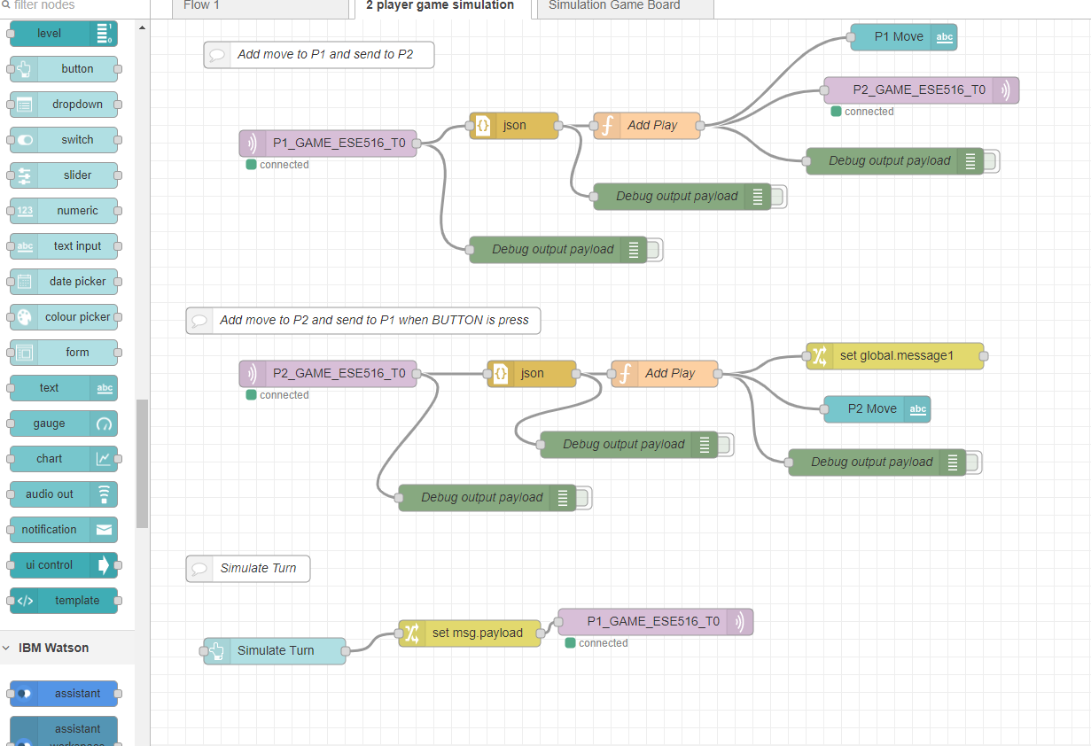
Node-Red
You should now have the ESE516 Simulator on your flow. Take some time to explore what is going on! The next slider will explain some of the most important nodes.

Slide 33

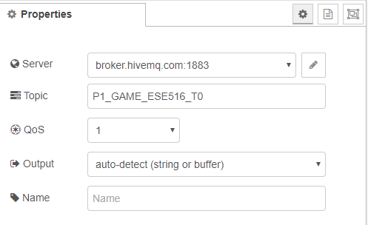
Node-Red – MQTT IN
MQTT Node: The MQTT IN NODE listens to a command received from a broker. If you double click it you can edit what it listens to! Notice that it is connected to the MQTT broker we mentioned before, and is listening to the P1_GAME_ESE516_T0. You will need to change this T0 to a unique number so it does not conflict with your colleagues!

Slide 34
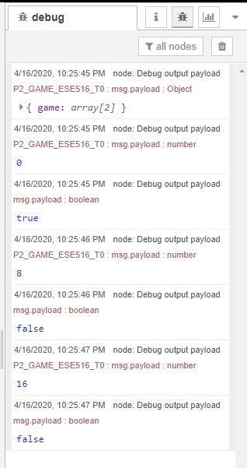

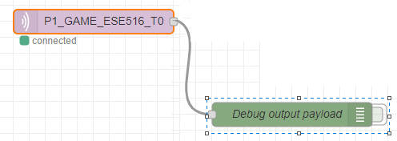
Node-Red – debug node
Click to clear output!
Debug NODE: Connected to this node is a DEBUG NODE. A debug node will print whatever it is connected to on the debug window. You can get to this window on the right screen of the backend view of Node Red (where you see the nodes). You can click on the green rectangle to activate/deactivate debug output.
Activated!
Click to activate

Slide 35
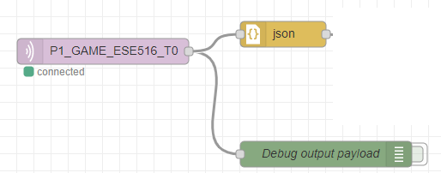
Node-Red JSON Block
The JSON block converts a JSON string into a Javascript Object. This will allow us to use Javascript on the data later on!

Slide 36

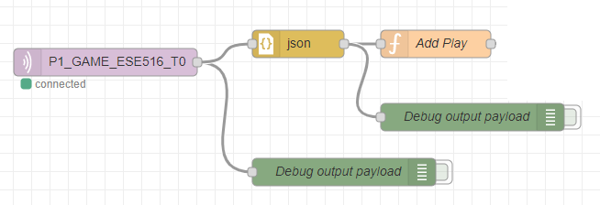
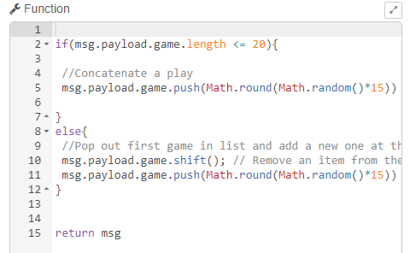
Node-Red Javacript Block (Function)
The function block can be added to run Javascript code! Double click on “Add Play” to see its code. In our example, this block is used to add a game play (random number between 0 to 15) to the end of the received play!
Function block

Slide 37
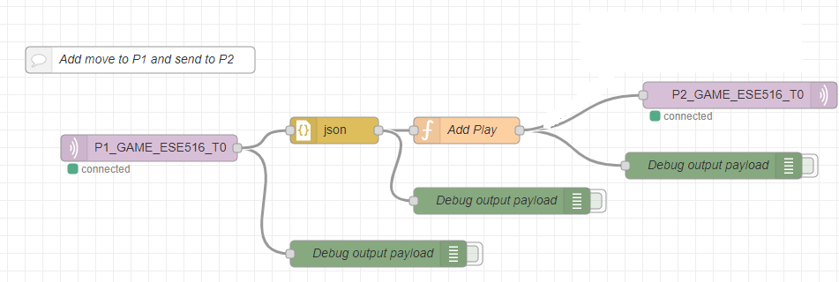
MQTT Out Block
MQTT Out button: Similar to the MQQT in, the MQTT Out will publish data to an MQTT Topic. In this case, we publist to the player 2 (P2_GAME_ESE516_T0).

Slide 38
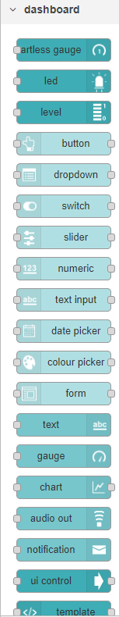
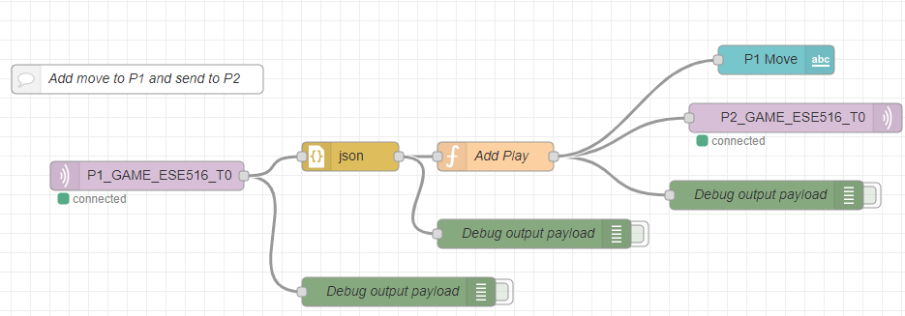
Front end (ui) blocks
There are going to be special nodes (listed under DASHBOARD) that will allow us to develop a front end GUI. In this example, we use a text label that prints the output to P2.

Slide 39
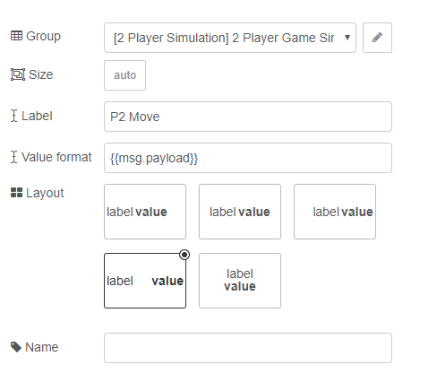
Node-Red UI
When you double click a dashboard component you can modify how it will look! You can also assign to what group it will be added to (where it will be shown on the UI).

Slide 40
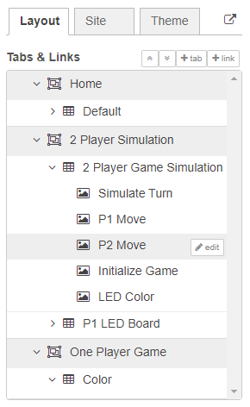
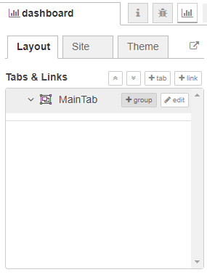
Node-Red UI
To configure the Layout of Dashboard block, you will need to configure the layout. To do so you can click on the topright layout button. On the layout tab you can add tabs and modify the position of existing DASHBOARD blocks into new groups.
Example of layout of our flow. For example the string we saw, P2 Move, is on the 2 PLAYER GAME SIMULATION Tab.

Slide 41

Node-Red- Deploy
Once you made changes and want to deploy your new code, hit the “Deploy” button on the top right. This will deploy your flow! It will mention any issues that might arise if they are present.

Slide 42
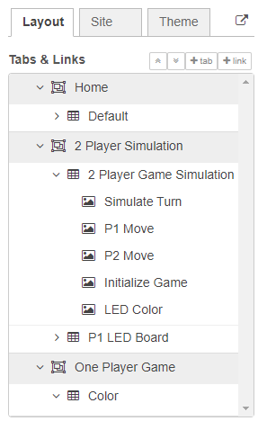
GOING TO THE UI
You can open the UI Website by clicking on the link in the Layout table.

Slide 43
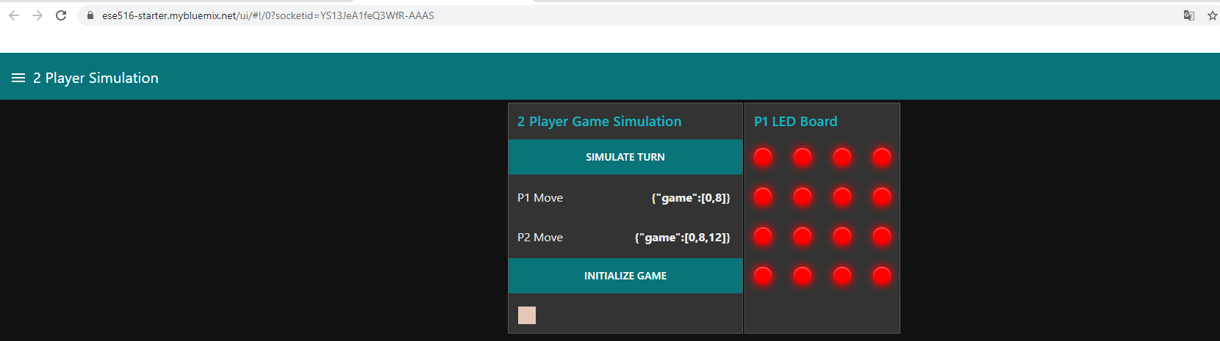
NODE RED DASHBOARD
Website you can access from anywhere to see your dashboard
UI Organized by how you did it on the UI options

Slide 44
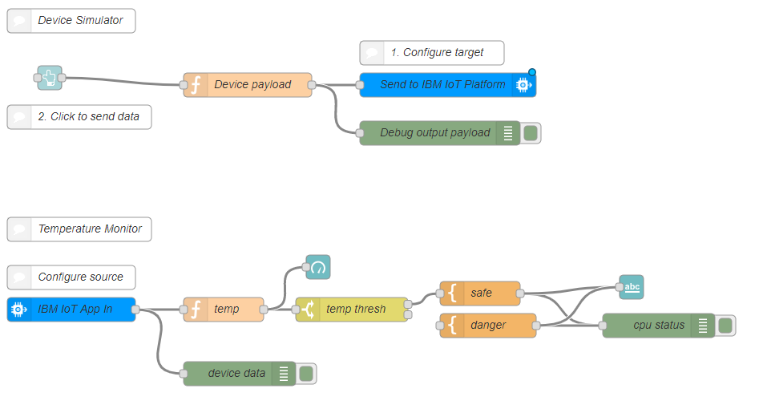
COOL! I want to learn more!
Node Red Cookbook: https://cookbook.nodered.org/
Node Red Tutorial: http://noderedguide.com/

